Slide 1
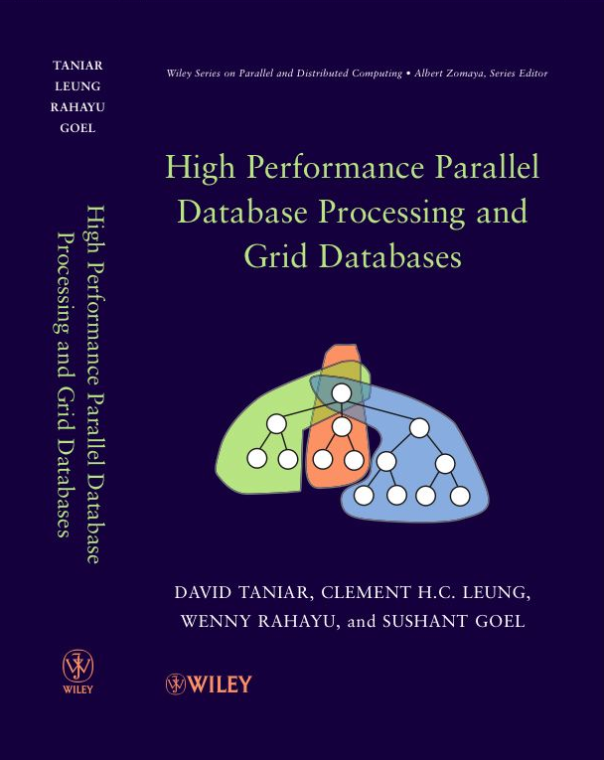
Chapter 1 Introduction
1.1 A Brief Overview - Parallel Databases and Grid Databases
1.2 Parallel Query Processing: Motivations
1.3 Parallel Query Processing: Objectives
1.4 Forms of Parallelism
1.5 Parallel Database Architectures
1.6 Grid Database Architecture
1.7 Structure of this Book
1.8 Summary
1.9 Bibliographical Notes
1.10 Exercises

Slide 2
1.1. A Brief Overview
Moore’s Law: number of processors will double every 18-24 months
CPU performance would increase by 50-60% per year
Mechanical delays restrict the advancement of disk access time or disk throughput (8-10% only)
Disk capacity also increases at a much higher rate
I/O becomes a bottleneck
Hence, motivates parallel database research
D. Taniar, C.H.C. Leung, W. Rahayu, S. Goel: High-Performance Parallel Database Processing and Grid Databases, John Wiley & Sons, 2008

Slide 3
1.1. A Brief Overview (cont’d)
Parallel Database Systems:
Single administrative domain
Homogeneous working environment
Close proximity of data storage
Multiple processors
Grid Database Systems:
Heterogeneous collaboration of resources
Provide seamless access to geographically distributed data sources
D. Taniar, C.H.C. Leung, W. Rahayu, S. Goel: High-Performance Parallel Database Processing and Grid Databases, John Wiley & Sons, 2008

Slide 4
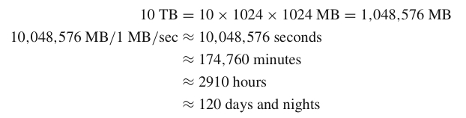
1.2. Motivations
An example:
D. Taniar, C.H.C. Leung, W. Rahayu, S. Goel: High-Performance Parallel Database Processing and Grid Databases, John Wiley & Sons, 2008

Slide 5
1.2. Motivations (cont’d)
What is parallel processing, and why not just use a faster computer ?
Even fast computers have speed limitations
Limited by speed of light
Other hardware limitations
Parallel processing divides a large task into smaller subtasks
Database processing works well with parallelism (coarse-grained parallelism)
Lesser complexity but need to work with a large volume of data
D. Taniar, C.H.C. Leung, W. Rahayu, S. Goel: High-Performance Parallel Database Processing and Grid Databases, John Wiley & Sons, 2008

Slide 6
1.3. Objectives
The primary objective of parallel database processing is to gain performance improvement
Two main measures:
Throughput: the number of tasks that can be completed within a given time interval
Response time: the amount of time it takes to complete a single task from the time it is submitted
Metrics:
Speed up
Scale up
D. Taniar, C.H.C. Leung, W. Rahayu, S. Goel: High-Performance Parallel Database Processing and Grid Databases, John Wiley & Sons, 2008

Slide 7
1.3. Objectives
The primary objective of parallel database processing is to gain performance improvement
Two main measures:
Throughput: the number of tasks that can be completed within a given time interval
Response time: the amount of time it takes to complete a single task from the time it is submitted
Metrics:
Speed up
Scale up
D. Taniar, C.H.C. Leung, W. Rahayu, S. Goel: High-Performance Parallel Database Processing and Grid Databases, John Wiley & Sons, 2008

Slide 8
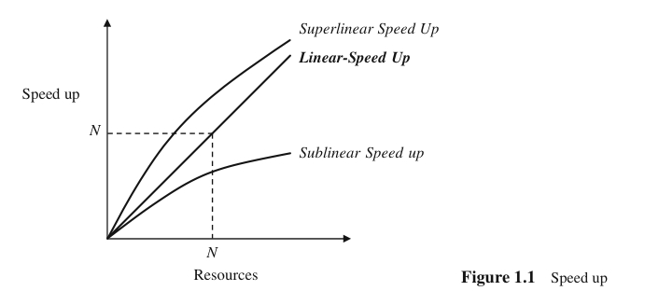

1.3. Objectives (cont’d)
Speed up
Performance improvement gained because of extra processing elements added
Running a given task in less time by increasing the degree of parallelism
Linear speed up: performance improvement growing linearly with additional resources
Superlinear speed up
Sublinear speed up
D. Taniar, C.H.C. Leung, W. Rahayu, S. Goel: High-Performance Parallel Database Processing and Grid Databases, John Wiley & Sons, 2008

Slide 9
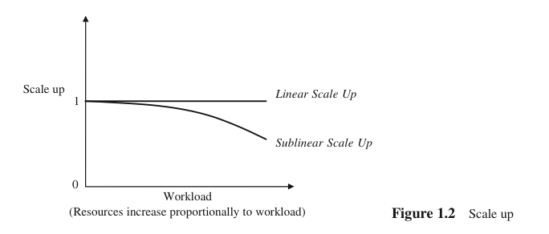

1.3. Objectives (cont’d)
Scale up
Handling of larger tasks by increasing the degree of parallelism
The ability to process larger tasks in the same amount of time by providing more resources.
Linear scale up: the ability to maintain the same level of performance when both the workload and the resources are proportionally added
Transactional scale up
Data scale up
D. Taniar, C.H.C. Leung, W. Rahayu, S. Goel: High-Performance Parallel Database Processing and Grid Databases, John Wiley & Sons, 2008

Slide 10
1.3. Objectives (cont’d)
Transaction scale up
The increase in the rate at which the transactions are processed
The size of the database may also increase proportionally to the transactions’ arrival rate
N-times as many users are submitting N-times as many requests or transactions against an N-times larger database
Relevant to transaction processing systems where the transactions are small updates
Data scale up
The increase in size of the database, and the task is a large job who runtime depends on the size of the database (e.g. sorting)
Typically found in online analytical processing (OLAP)
D. Taniar, C.H.C. Leung, W. Rahayu, S. Goel: High-Performance Parallel Database Processing and Grid Databases, John Wiley & Sons, 2008

Slide 11
1.3. Objectives (cont’d)
Parallel Obstacles
Start-up and Consolidation costs,
Interference and Communication, and
Skew
D. Taniar, C.H.C. Leung, W. Rahayu, S. Goel: High-Performance Parallel Database Processing and Grid Databases, John Wiley & Sons, 2008

Slide 12
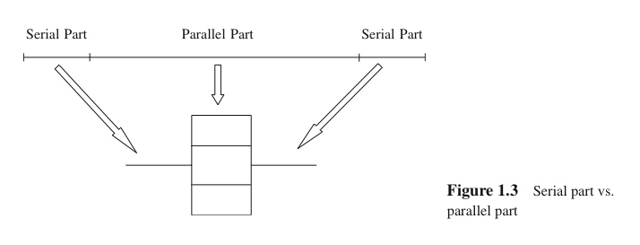
1.3. Objectives (cont’d)
Start-up and Consolidation
Start up: initiation of multiple processes
Consolidation: the cost for collecting results obtained from each processor by a host processor
D. Taniar, C.H.C. Leung, W. Rahayu, S. Goel: High-Performance Parallel Database Processing and Grid Databases, John Wiley & Sons, 2008

Slide 13
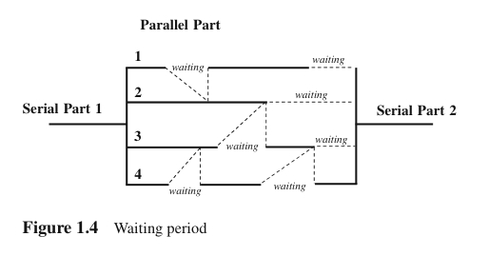
1.3. Objectives (cont’d)
Interference and Communication
Interference: competing to access shared resources
Communication: one process communicating with other processes, and often one has to wait for others to be ready for communication (i.e. waiting time).
D. Taniar, C.H.C. Leung, W. Rahayu, S. Goel: High-Performance Parallel Database Processing and Grid Databases, John Wiley & Sons, 2008

Slide 14
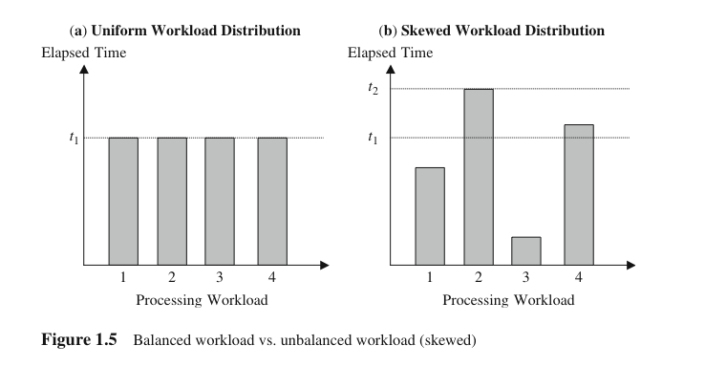
1.3. Objectives (cont’d)
Skew
Unevenness of workload
Load balancing is one of the critical factors to achieve linear speed up
D. Taniar, C.H.C. Leung, W. Rahayu, S. Goel: High-Performance Parallel Database Processing and Grid Databases, John Wiley & Sons, 2008

Slide 15
1.4. Forms of Parallelism
Forms of parallelism for database processing:
Interquery parallelism
Intraquery parallelism
Interoperation parallelism
Intraoperation parallelism
Mixed parallelism
D. Taniar, C.H.C. Leung, W. Rahayu, S. Goel: High-Performance Parallel Database Processing and Grid Databases, John Wiley & Sons, 2008

Slide 16
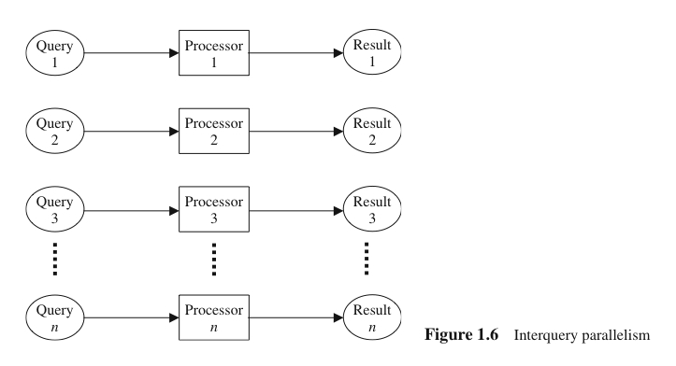
1.4. Forms of Parallelism (cont’d)
Interquery Parallelism
“Parallelism among queries”
Different queries or transactions are executed in parallel with one another
Main aim: scaling up transaction processing systems
D. Taniar, C.H.C. Leung, W. Rahayu, S. Goel: High-Performance Parallel Database Processing and Grid Databases, John Wiley & Sons, 2008

Slide 17
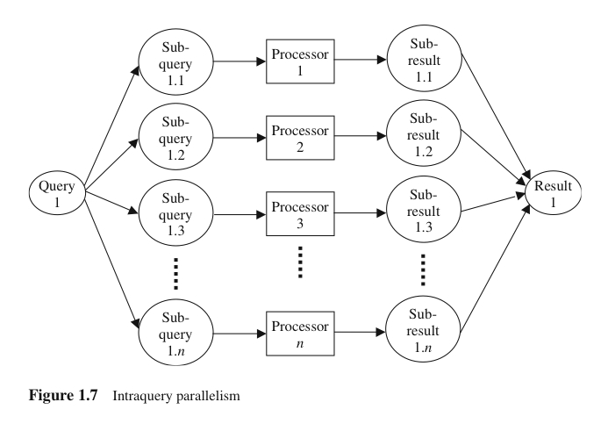
1.4. Forms of Parallelism (cont’d)
Intraquery Parallelism
“Parallelism within a query”
Execution of a single query in parallel on multiple processors and disks
Main aim: speeding up long-running queries
D. Taniar, C.H.C. Leung, W. Rahayu, S. Goel: High-Performance Parallel Database Processing and Grid Databases, John Wiley & Sons, 2008

Slide 18
1.4. Forms of Parallelism (cont’d)
Execution of a single query can be parallelized in two ways:
Intraoperation parallelism: Speeding up the processing of a query by parallelizing the execution of each individual operation (e.g. parallel sort, parallel search, etc)
Interoperation parallelism: Speeding up the processing of a query by executing in parallel different operations in a query expression (e.g. simultaneous sorting or searching)
D. Taniar, C.H.C. Leung, W. Rahayu, S. Goel: High-Performance Parallel Database Processing and Grid Databases, John Wiley & Sons, 2008

Slide 19
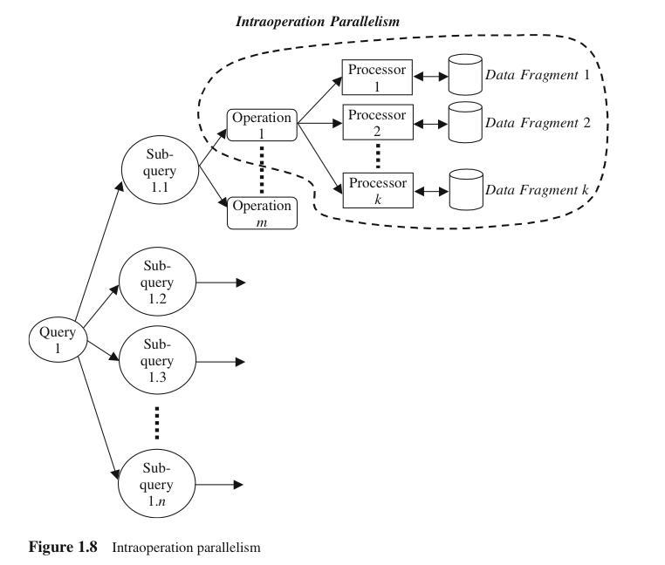
1.4. Forms of Parallelism (cont’d)
Intraoperation Parallelism
“Partitioned parallelism”
Parallelism due to the data being partitioned
Since the number of records in a table can be large, the degree of parallelism is potentially enourmous
D. Taniar, C.H.C. Leung, W. Rahayu, S. Goel: High-Performance Parallel Database Processing and Grid Databases, John Wiley & Sons, 2008

Slide 20
1.4. Forms of Parallelism (cont’d)
Interoperation parallelism: Parallelism created by concurrently executing different operations within the same query or transaction
Pipeline parallelism
Independent parallelism
D. Taniar, C.H.C. Leung, W. Rahayu, S. Goel: High-Performance Parallel Database Processing and Grid Databases, John Wiley & Sons, 2008

Slide 21
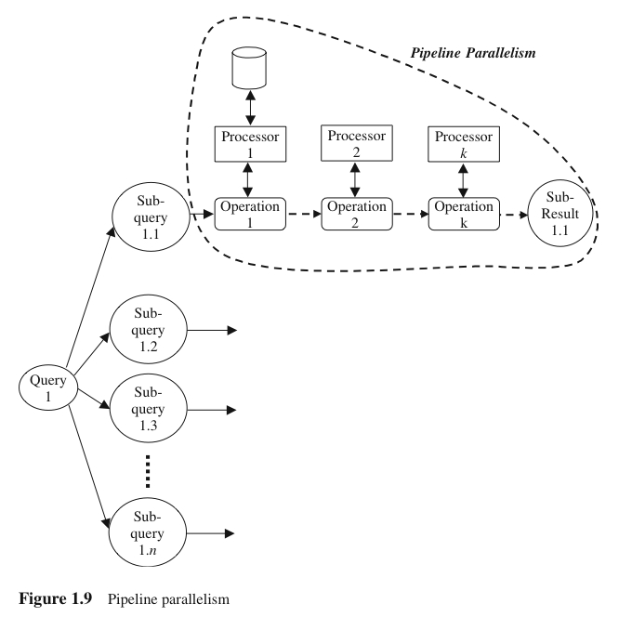
1.4. Forms of Parallelism (cont’d)
Pipeline Parallelism
Output record of one operation A are consumed by a second operation B, even before the first operation has produced the entire set of records in its output
Multiple operations form some sort of assembly line to manufacture the query results
Useful with a small number of processors, but does not scale up well
D. Taniar, C.H.C. Leung, W. Rahayu, S. Goel: High-Performance Parallel Database Processing and Grid Databases, John Wiley & Sons, 2008

Slide 22
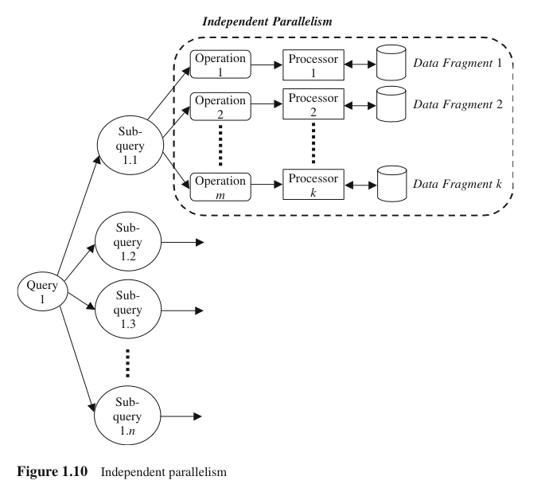
1.4. Forms of Parallelism (cont’d)
Independent Parallelism
Operations in a query that do not depend on one another are executed in parallel
Does not provide a high degree of parallelism
D. Taniar, C.H.C. Leung, W. Rahayu, S. Goel: High-Performance Parallel Database Processing and Grid Databases, John Wiley & Sons, 2008

Slide 23
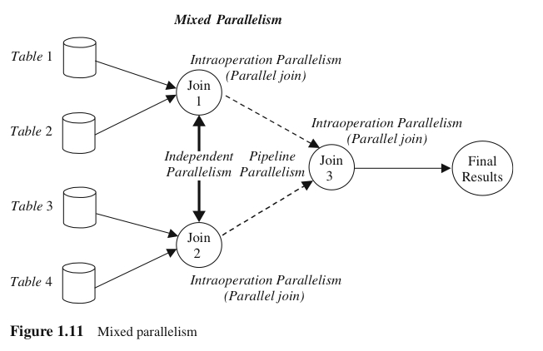
1.4. Forms of Parallelism (cont’d)
Mixed Parallelism
In practice, a mixture of all available parallelism forms is used.
D. Taniar, C.H.C. Leung, W. Rahayu, S. Goel: High-Performance Parallel Database Processing and Grid Databases, John Wiley & Sons, 2008

Slide 24
1.5. Parallel Database Architectures
Parallel computers are no longer a monopoly of supercomputers
Parallel computers are available in many forms:
Shared-memory architecture
Shared-disk architecture
Shared-nothing architecture
Shared-something architecture
D. Taniar, C.H.C. Leung, W. Rahayu, S. Goel: High-Performance Parallel Database Processing and Grid Databases, John Wiley & Sons, 2008

Slide 25
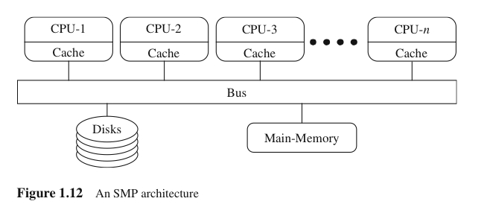
1.5. Parallel Database Architectures (cont’d)
Shared-Memory and Shared-Disk Architectures
Shared-Memory: all processors share a common main memory and secondary memory
Load balancing is relatively easy to achieve, but suffer from memory and bus contention
Shared-Disk: all processors, each of which has its own local main memory, share the disks
D. Taniar, C.H.C. Leung, W. Rahayu, S. Goel: High-Performance Parallel Database Processing and Grid Databases, John Wiley & Sons, 2008

Slide 26
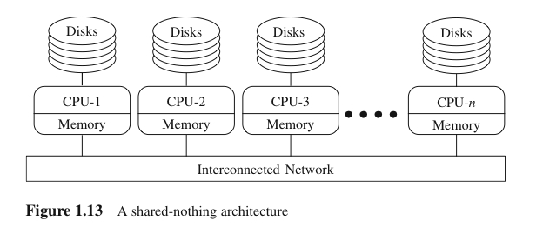
1.5. Parallel Database Architectures (cont’d)
Shared-Nothing Architecture
Each processor has its own local main memory and disks
Load balancing becomes difficult
D. Taniar, C.H.C. Leung, W. Rahayu, S. Goel: High-Performance Parallel Database Processing and Grid Databases, John Wiley & Sons, 2008

Slide 27
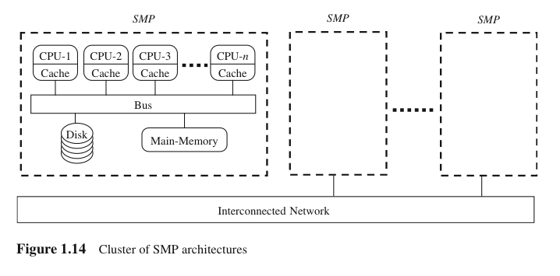
1.5. Parallel Database Architectures (cont’d)
Shared-Something Architecture
A mixture of shared-memory and shared-nothing architectures
Each node is a shared-memory architecture connected to an interconnection network ala shared-nothing architecture
D. Taniar, C.H.C. Leung, W. Rahayu, S. Goel: High-Performance Parallel Database Processing and Grid Databases, John Wiley & Sons, 2008

Slide 28
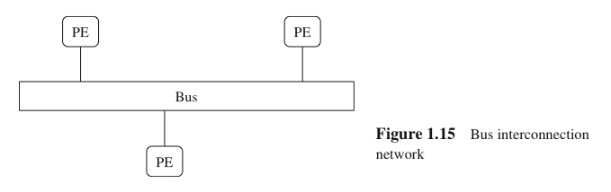
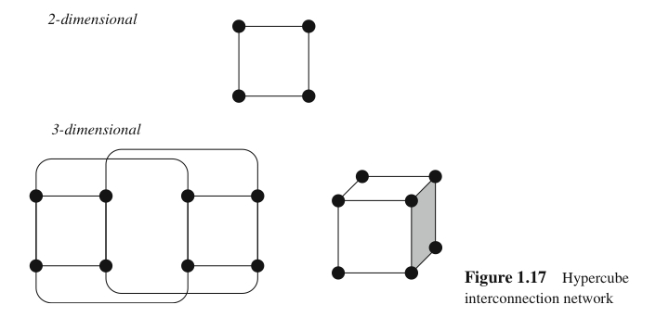

1.5. Parallel Database Architectures (cont’d)
Interconnection Networks
Bus, Mesh, Hypercube
D. Taniar, C.H.C. Leung, W. Rahayu, S. Goel: High-Performance Parallel Database Processing and Grid Databases, John Wiley & Sons, 2008

Slide 29
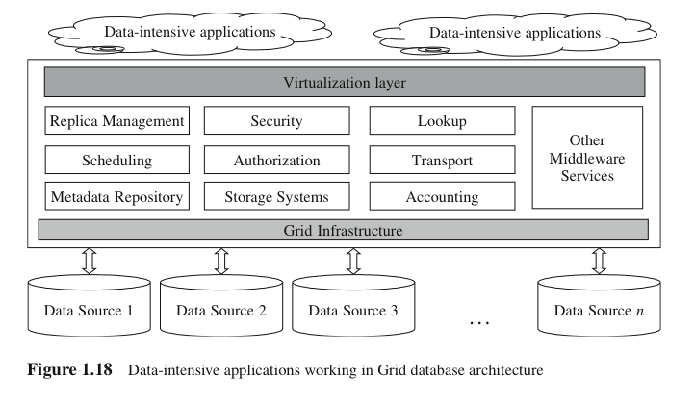
1.6. Grid Database Architecture
Wide geographical area, autonomous and heterogeneous environment
Grid services (Meta-repository services, look-up services, replica management services, …)
Grid middleware
D. Taniar, C.H.C. Leung, W. Rahayu, S. Goel: High-Performance Parallel Database Processing and Grid Databases, John Wiley & Sons, 2008

Slide 30
1.7. Structure of the book
Part I: Introduction and analytical models
Parts II and III: Parallel query processing, including parallel algorithms and methods for all important database processing operations
Part IV: Grid transaction management, covering the ACID properties of transaction as well as replication in Grid
Part V: Parallelism of other data-intensive applications (OLAP and data mining)
D. Taniar, C.H.C. Leung, W. Rahayu, S. Goel: High-Performance Parallel Database Processing and Grid Databases, John Wiley & Sons, 2008

Slide 31
1.8. Summary
Why, What, and How of parallel query processing:
Why is parallelism necessary in database processing?
What can be achieved by parallelism in database processing?
How parallelism performed in database processing?
What facilities of parallel computing can be used?
D. Taniar, C.H.C. Leung, W. Rahayu, S. Goel: High-Performance Parallel Database Processing and Grid Databases, John Wiley & Sons, 2008

Slide 32
Continue to Chapter 2…

